Slide 1
MSR HEDGING STRATEGIES
Group 22
Hiteeksha Mathur Ghai
Nikhila Venugopal
Prakhar Jain
Pranay Khattri
Samrudhi Bokade
Academic Advisor: Prof. Levon Goukasian
Company: MUFG Union Bank
Company Contact: Achal Shah.

Slide 2
CONTENT
Introduction
Background
Objective
Data Description
Methodology & Analysis
Results / Findings

Slide 3
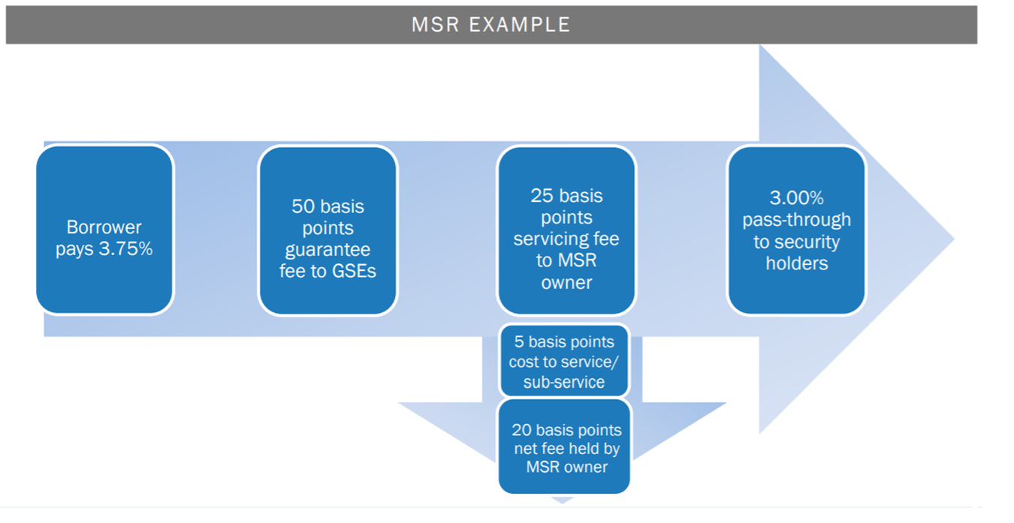
INTRODUCTION
Banks typically hold the rights to service the loans which involves collecting and disbursing Principal, Interest, Taxes and Insurance payments; foreclosure/modification, etc. These rights are called Mortgage Servicing Rights (MSR).

Slide 4
BACKGROUND
Mortgage servicing rights (MSRs) represent the rights to receive an income in exchange for providing a set of servicing related functions for mortgage loans. These are rights to service the loans.
It is generally around 25 bps- 50 bps.
These servicing functions include the monthly collection of and accounting for principal and interest payments from borrowers, the pass through of principal and interest to investors, managing and accounting for escrow payments for taxes and insurance, providing tax information to borrowers and investors, sending out late notices, engaging in loan modifications . (Andy Terry)
Mortgage servicing may be performed by the original lender, or the lender may sell the right to service a mortgage to another company, which performs the service for a fee. Some companies, including some savings associations, specialize in servicing mortgages, both their own and those made by other lenders.

Slide 5
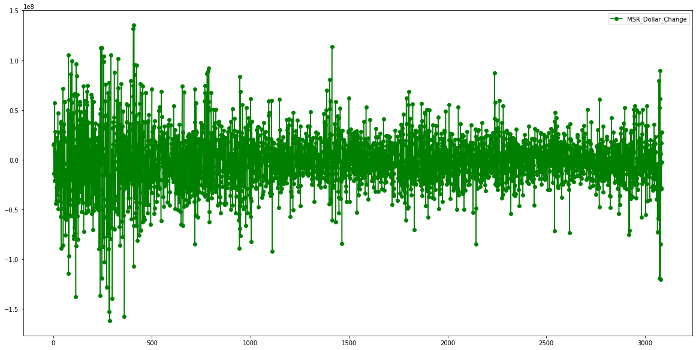
IMPORTANCE OF HEDGING MSR
MSR is one of the most volatile assets in fixed income markets, extremely sensitive to daily changes in interest rates, prepayments, housing prices, defaults and model assumptions.
They are a small part of the balance sheet but can be a big (negative or positive) part of income unless hedged correctly.
MSR Daily Dollar Changes

Slide 6
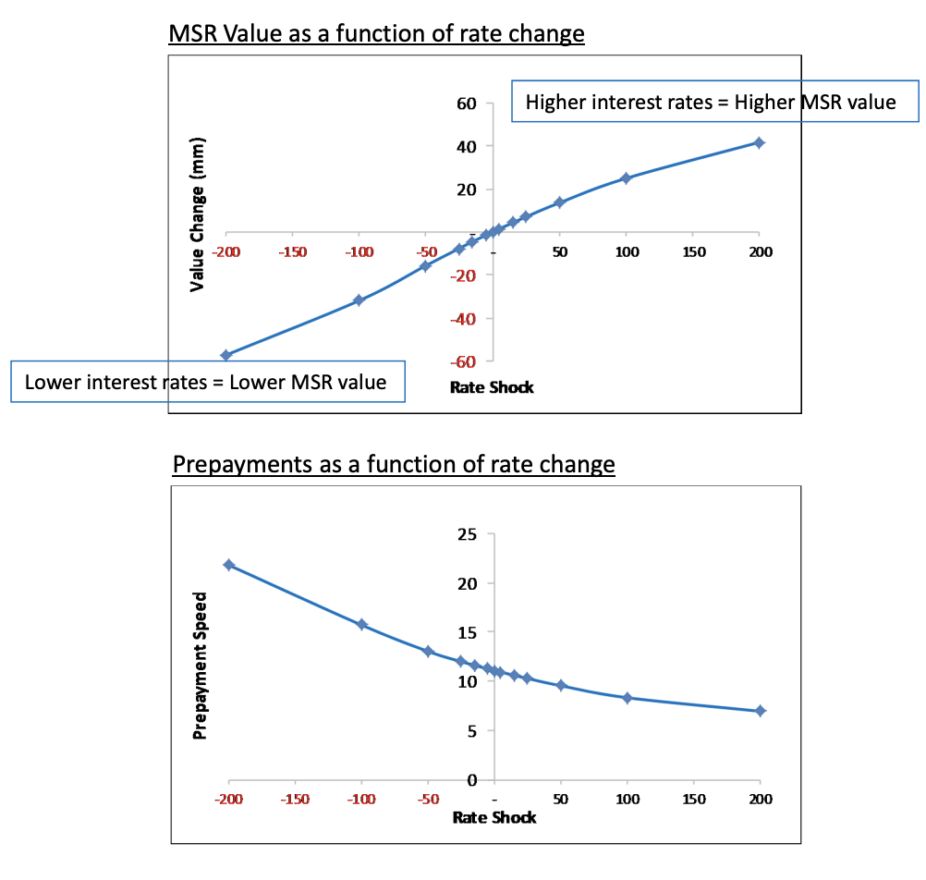
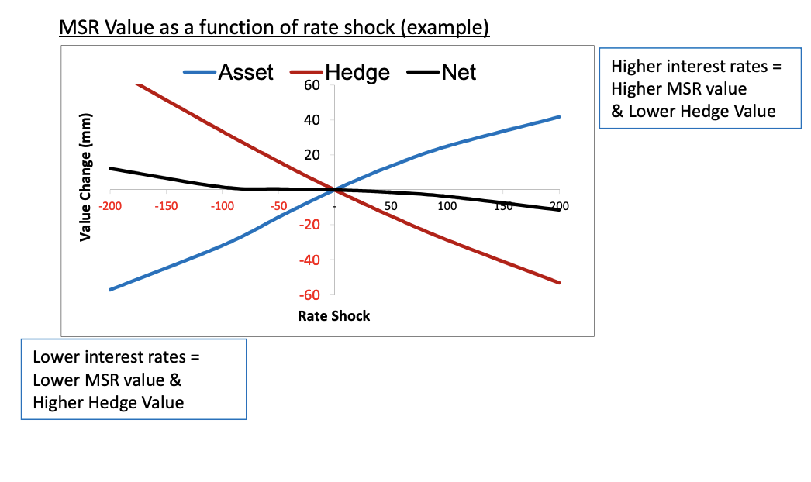
MSR RISK PROFILE TO INTEREST RATES – UNHEDGED/HEDGED

Slide 7
OBJECTIVE
MUFG, in order to enhance non-interest income does MSR purchases.
These MSRs are sensitive to interest rate changes that need to be hedged
Our project is about hedging Mortgage Servicing Rights (MSR) using Swaps and TBAs for Static MSR. Depending upon the negative convexity in MSR we would like to hedge MSR also with the Swaptions- exposure to volatility.
Then derive the Mean-VaR efficient frontier for MSR-hedge portfolio.

Slide 8
MSR HEDGING
MBS hedging occurs primarily through a combination of two strategies:
Delta hedging:
In a rising rate environment, this would involve paying in swaps, selling Treasury futures and selling MBS (typically, TBA). This would argue for higher rates led by the belly of the curve, cheapening of futures to cash, and wider MBS basis.
Convexity hedging:
Investors may hedge the negative convexity of the MBS by owning gamma. This could involve buying swaptions, Treasury options or mortgage options. This results in a higher levels of implied vol and a richening of the payer skew.
Notes:
Strategies for hedging MSR and the instruments we will use for this purpose:
Pay fixed in swaps when rates rise; Pay floating rate- profit when rates decrease
Payer swaption- option to pay fixed rate when rates rise

Slide 9
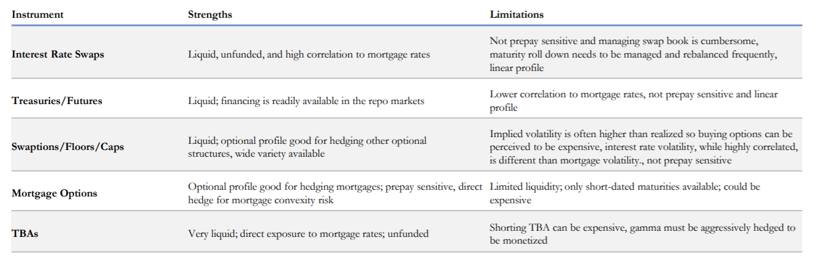
MSR HEDGING INSTRUMENTS
Static MSR is sensitive to Swaps (5y, 7y and 10y) and Secondary Mortgage Rates (15y and 30y).
Notes:
Swaps and swaptions cannot hedge prepayment risk- for which we have to use TBAs
Mortgage options are not very liquid so we use other instruments

Slide 10
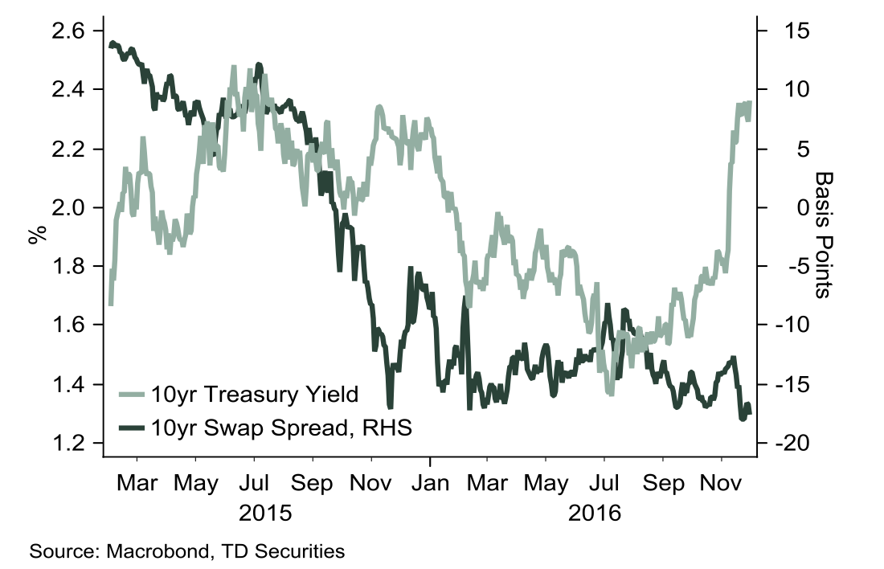
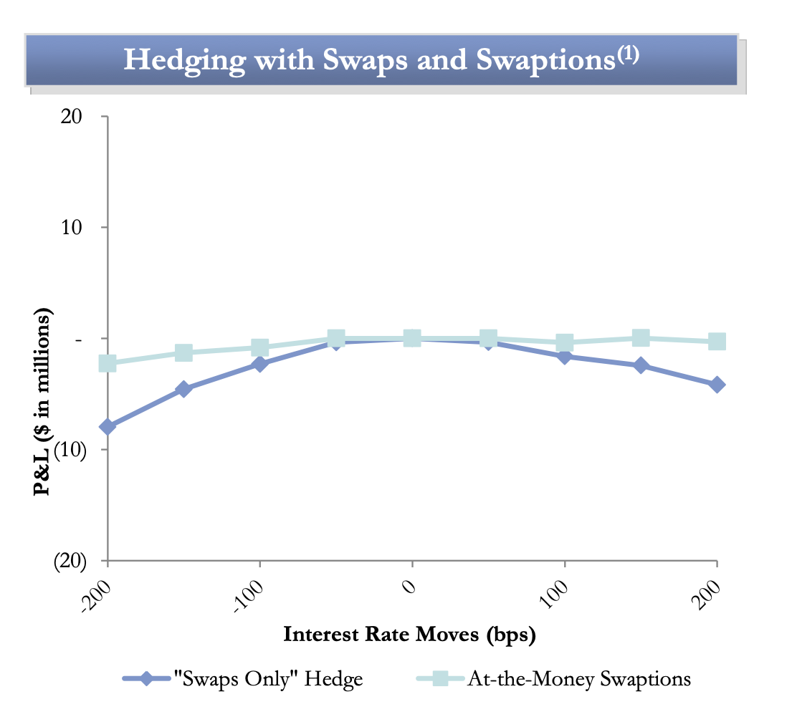
MSR HEDGING INSTRUMENTS
Why Swaps?
Swap spreads barely widened despite rate increase and can hedge interest rate risk
Why Swaptions?
Uncertain cash flows and convexity hedged by buying back volatility through options
Swap spreads
Swaption hedging volatility risk
TBAs are used to reduce prepayment risk by protecting MSR values from changes in Current Coupon Rates
Notes:
TBA- forward-settling mortgage-backed securities ; actual mortgage-backed security that will be delivered to fulfill a TBA trade is not designated at the time the trade is made.

Slide 11
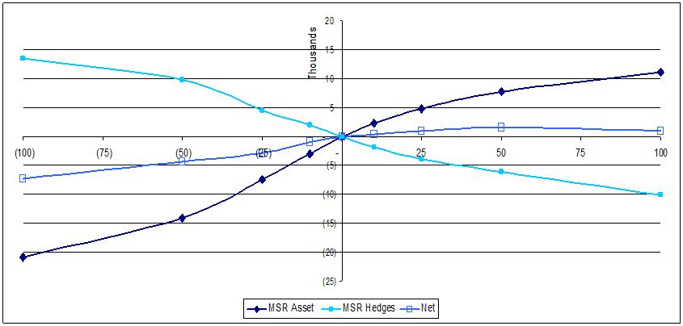
MANAGING CONVEXITY
MSR assets exhibit negative convexity; Add assets with positive convexity
Duration of MSR asset will diverge from Duration of hedge portfolio
The bank monitors and rebalances its hedge position daily/ intraday
Match the rate at which the value of the Hedge changes and the rate at which the value of the MSR changes (i.e., to match the durations)
Notes:
The MSR asset typically exhibits negative convexity. This means the rate at which MSR assets decrease in value accelerates as rates fall and the rate at which the MSR asset increases in value decelerates as rates rise.
While we try to add instruments with positive convexity in our hedging portfolio, the magnitude of that positive convexity is usually smaller than the negative convexity exhibited by the MSR asset.
This difference in convexity profiles means as rates move the duration of the MSR asset will diverge from the duration of the hedge portfolio.
To reduce hedge ineffectiveness caused by the mismatched convexity profiles, the bank monitors and rebalances its hedge position on a daily (and intraday) basis.
The rebalancing is conducted to match, for small movements in interest rates, the rate at which the value of the hedge changes to the rate at which the value of the MSR changes (i.e., to match the durations)

Slide 12
DATA DESCRIPTION
TBA sensitivity profile
Sensitivity profile for single path static MSR
Historical Swap rates : 2007 – 2020
Historical FNCL and FNCI rates: 2007 - 2020
Swaption Volatility : 2007 - 2020
SAA

Slide 13
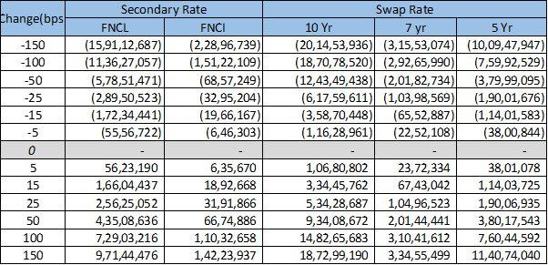
DATA DESCRIPTION
MSR Profile
SAA

Slide 14
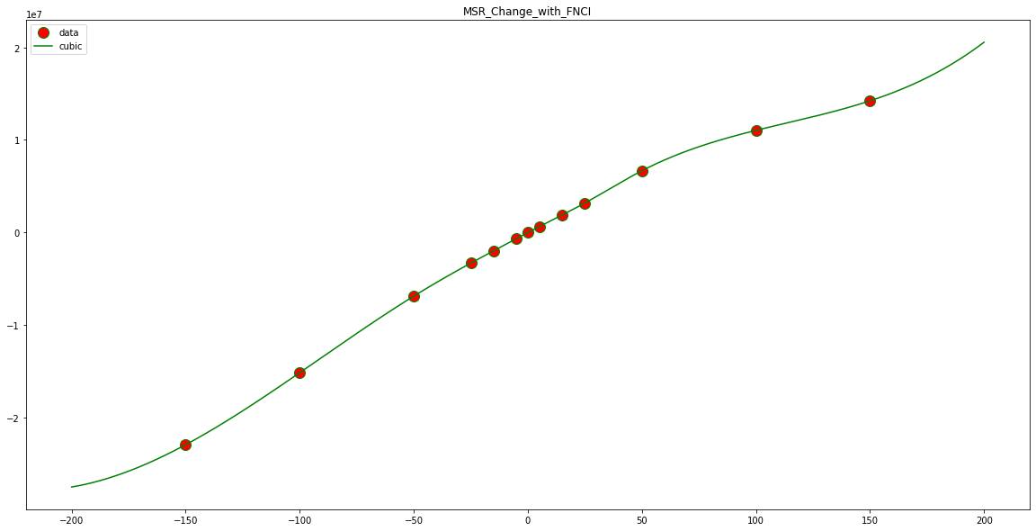
DATA DESCRIPTION
MSR Profile Fit: Changes to FNCI

Slide 15
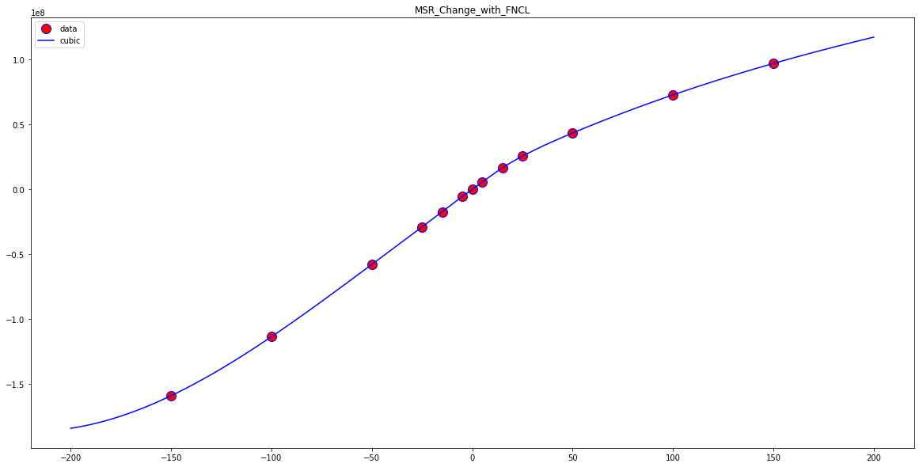
DATA DESCRIPTION
MSR Profile Fit: Changes to FNCL

Slide 16
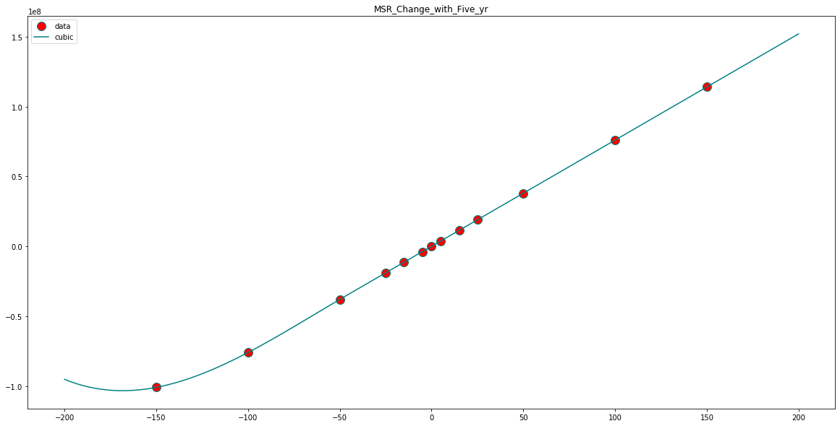
DATA DESCRIPTION
MSR Profile Fit: Changes to 5-Year Swap Rate

Slide 17
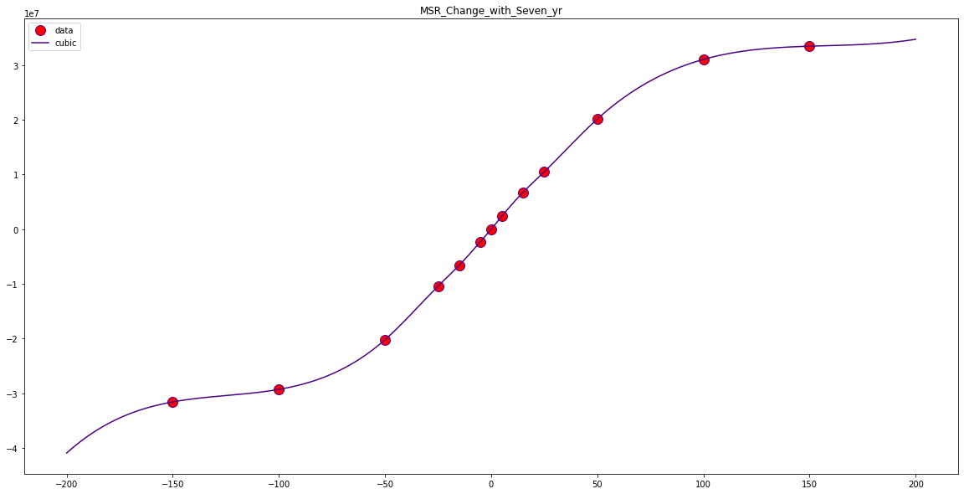
DATA DESCRIPTION
MSR Profile Fit: Changes to 7-Year Swap Rate

Slide 18
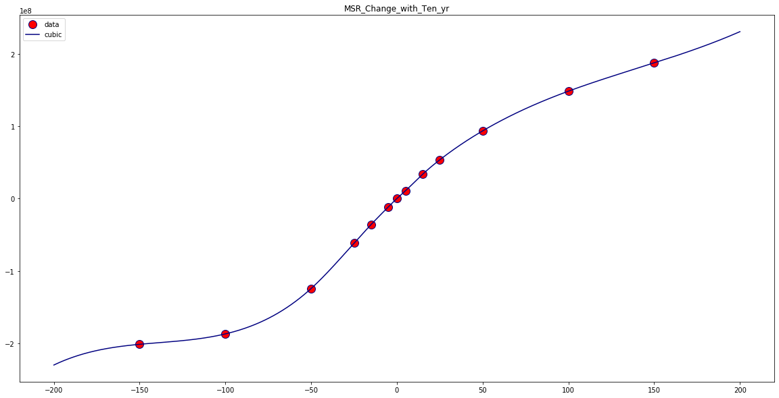
DATA DESCRIPTION
MSR Profile Fit: Changes to 10-Year Swap Rate

Slide 19
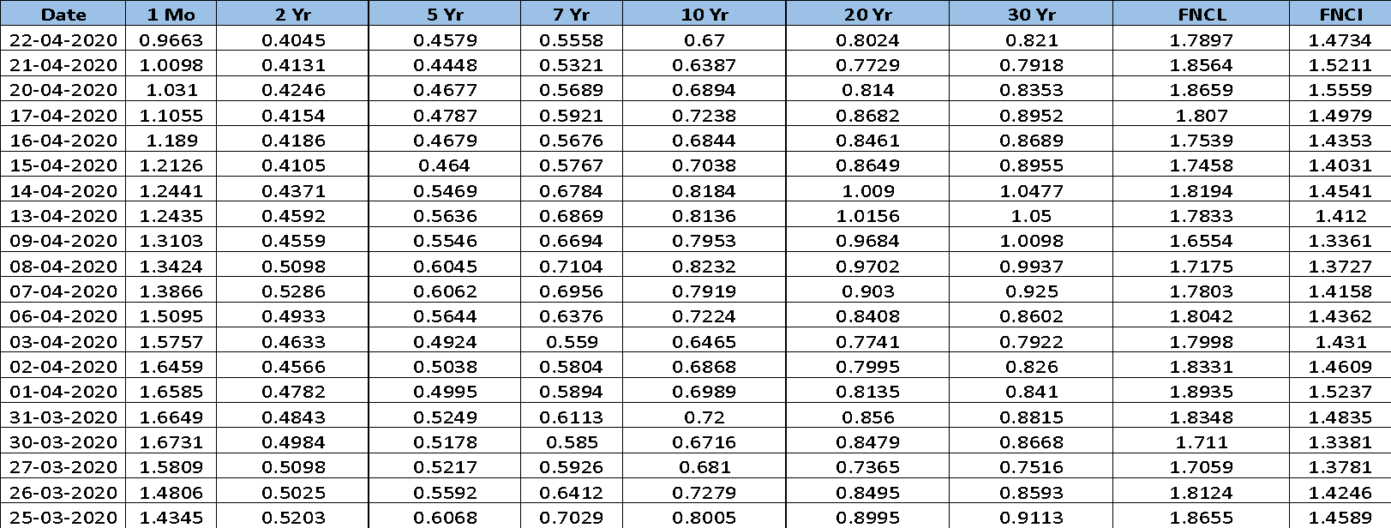
DATA DESCRIPTION
Historical Swap Rates
SAA
TBA Profile
TBA Profile
Rate Shock (bps) | -200 | -100 | -50 | -25 | 0 | 25 | 50 | 100 | 200
Change in Market Value | 70,40,794 | 67,80,513 | 43,28,073 | 23,51,380 | - | (26,23,480) | (54,19,446) | (1,13,27,065) | (2,35,48,644)

Slide 20
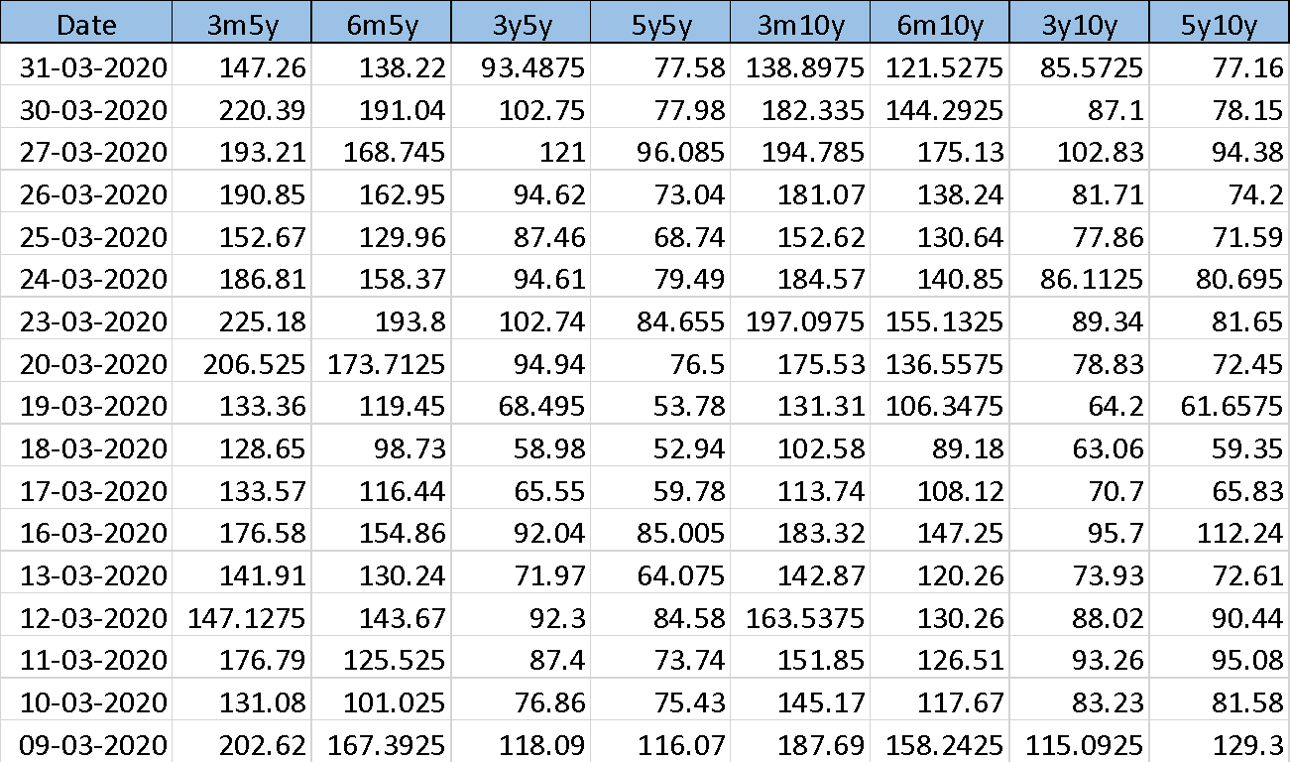
DATA DESCRIPTION
ATM Swaption Black LIBOR Vols
SAA

Slide 21
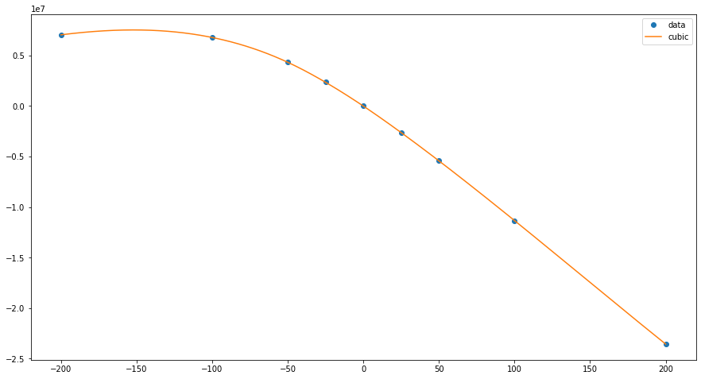
METHODOLOGY & ANALYSIS
PHASE 1:
MSR:
MSR profile fitted using Cubic Spline w.r.t FNCL, FNCI and 3 swap rates
Daily changes for MSR calculated using spline fit.
TBA:
TBA profile fitted using Cubic Spline.
Assumption: Affected only by FNCL rates.
Daily changes for TBA calculated using spline fit.
DV01 and CV01 were computed -$99497.18 & $-435.36 respectively.
TBA Profile Fit- Cubic Spline

Slide 22
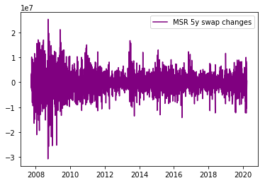
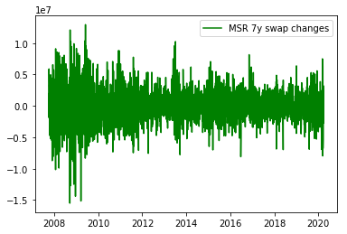
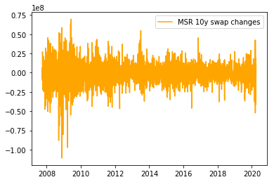
MSR changes w.r.t swaps

Slide 23
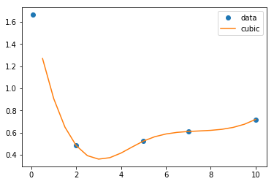
METHODOLOGY & ANALYSIS
Implement functions for building Yield Curve using Swap Rates, Valuing Swaps and Swaptions.
Swap rates were interpolated using spline function
Discount factors were calculated from swap rates by bootstrapping.
DV01 was computed and daily changes for Swap were calculated.
Swap Profile Fit- Cubic Spline

Slide 24
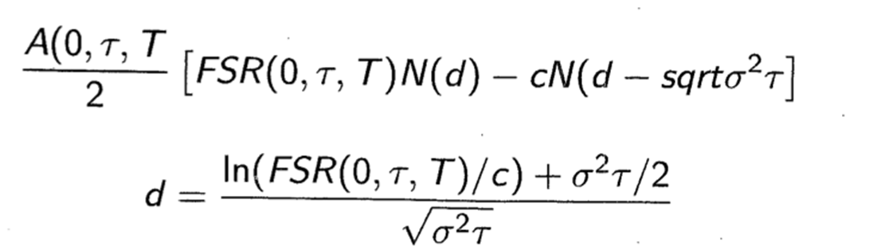
METHODOLOGY & ANALYSIS
SWAPTIONS:
Valued using Black model
DV01, CV01 and Vega were computed
Daily changes of Swaptions calculated using DV01, CV01 and Vega
MSR has negative convexity which was hedged using Swaption
SAA

Slide 25
METHODOLOGY & ANALYSIS
PHASE 2:
Determine the hedging ratios
TBA ratio is calculated based on MSR key rate DV01 w.r.t FNCL and FNCI and TBA DV01.
Swaption weight is calculated based on MSR and swaption CV01.
Swap weights are calculated based on MSR key rate DV01s (net of swaption) w.r.t 5-year, 7-year, 10-year swap rate and swap’s DV01
Estimate VaR for the hedged portfolio
Equal weighted historically simulated 99% daily VaR
Develop Mean-VaR efficient frontier to determine optimal strategy.
SAA

Slide 26
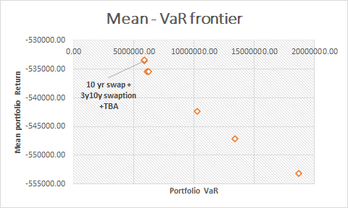
RESULTS
Optimal hedged portfolio composition (31/03/2020):
MSR asset (market value $1,098,980,779)
12.5 units of TBA
$25,090,600 notional of 10 year ATM swap
$47,822,820 3-year - 10 year payer swaption
VaR for the portfolio = $5,085,797 (on ‘2008-10-15’)

Slide 27
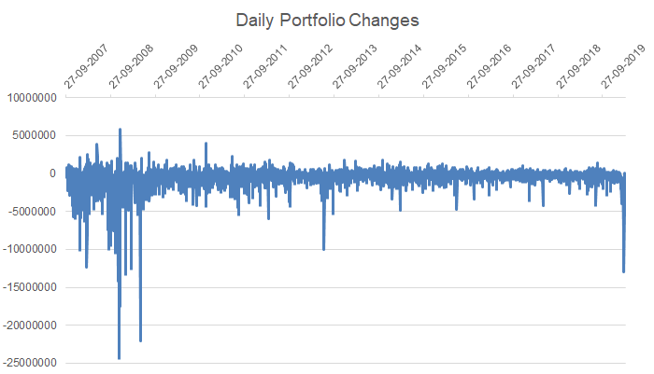
RESULTS
VaR for the hedged portfolio drops to $3,509,433 (~30%) if we exclude the financial crisis.

Slide 28
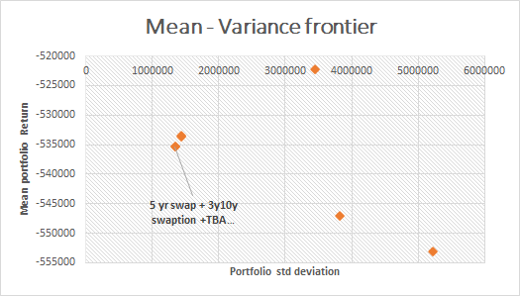
RESULTS
Portfolio based on Mean - Variance optimization
Portfolio : MSR + TBA + 5- year swap + 3y10y swaption

Slide 29
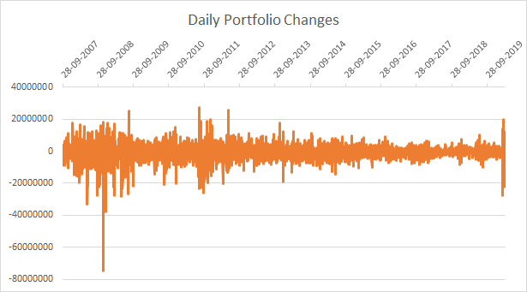
RESULTS
VaR for the portfolio based on Mean-variance is $18,717,011Mn.

Slide 30
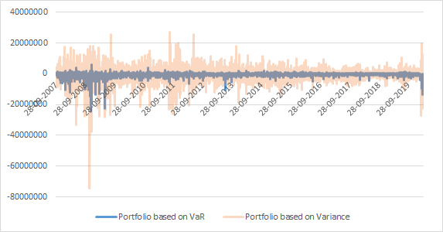
RESULTS

Slide 31
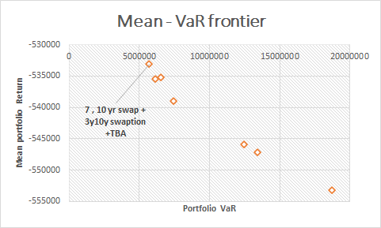
RESULTS
Forward looking analysis
Portfolio formed on ‘2014-04-16’
Optimal portfolio includes 7-year, 10-year swap + swaption + MSR + TBA.

Slide 32
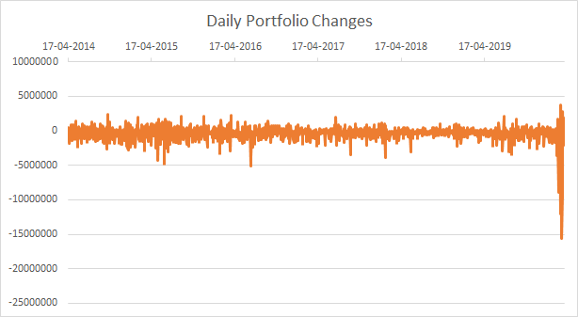
RESULTS
Portfolio - MSR + TBA + 7 year swap + 10 year swap + 3y10yswaption
VaR for the portfolio = $5,699,308 (on ‘2009-07-08’)

Slide 33
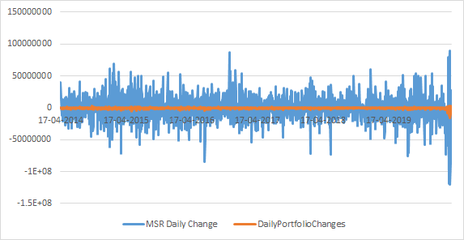
RESULTS
Portfolio - MSR + TBA + 7 year swap + 10 year swap + 3y10yswaption

Slide 34
THANK YOU

